Slide 1
Standard Forms of Boolean Expressions
Digital Logic Design

Slide 2
Standard Forms of Boolean Expressions
All Boolean expressions, regardless of their form, can be converted into either of two standard forms:
Sum of Product (SOP) also called Minterm.
Product of Sum (POS) also called Maxterm.

Slide 3

The Sum-of-Products (SOP) Form
When two or more product terms are summed by Boolean addition, the resulting expression is a sum-of-products (SOP).
Also, an SOP expression can contain a single-variable term, as in
However, more than one variable in a term can have an overbar. For example, an SOP expression can have the term but not

Slide 4
The Sum-of-Products (SOP) Form
The domain of a general Boolean expression is the set of variables contained in the expression in either complemented or uncomplemented form.
For example, the domain of the expression is A, B, C.
domain is A, B, C, D.

Slide 5
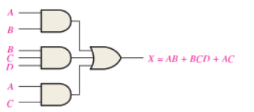
AND/OR Implementation of an SOP Expression
Implementing an SOP expression simply requires ORing the outputs of two or more AND gates. A product term is produced by an AND operation, and the sum (addition) of two or more product terms is produced by an OR operation.
Therefore, an SOP expression can be implemented by AND-OR logic in which the outputs of a number (equal to the number of product terms in the expression) of AND gates connect to the inputs of an OR gate, as shown in Figure

Slide 6

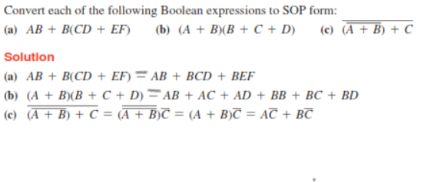
Conversion of a General Expression to SOP Form

Slide 7
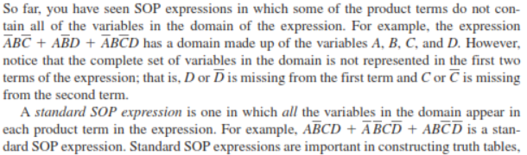
The Standard SOP Form

Slide 8
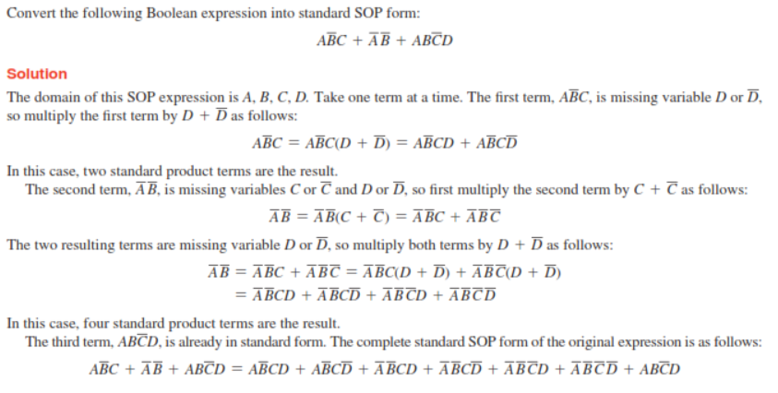
The Standard SOP Form

Slide 9
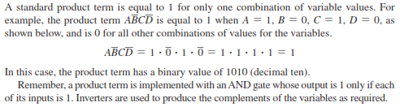
Binary Representation of a Standard Product Term
An SOP expression is equal to 1 only if one or more of the product terms in the expression is equal to 1

Slide 10
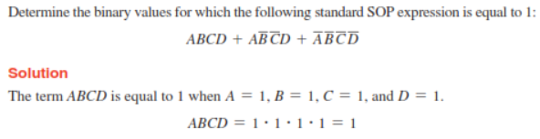
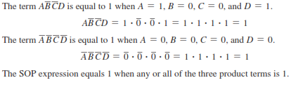
Binary Representation of a Standard Product Term (cont.)

Slide 11


The Product-of-Sums (POS) Form
When two or more sum terms are multiplied, the resulting expression is a product-of-sums (POS). Some examples are

Slide 12
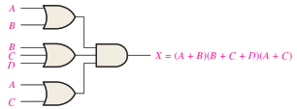
Implementation of a POS Expression
Implementing a POS expression simply requires ANDing the outputs of two or more OR gates. A sum term is produced by an OR operation, and the product of two or more sum terms is produced by an AND operation.
Therefore, a POS expression can be implemented by logic in which the outputs of a number (equal to the number of sum terms in the expression) of OR gates connect to the inputs of an AND gate, as Figur

Slide 13
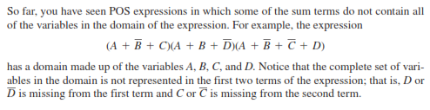
The Standard POS Form
A standard POS expression is one in which all the variables in the domain appear in each sum term in the expression.

Slide 14
Converting a Sum Term to Standard POS
Each sum term in a POS expression that does not contain all the variables in the domain can be expanded to standard form to include all variables in the domain and their complements.
As stated in the following steps, a nonstandard POS expression is converted into standard form using Boolean algebra rule 8 (A . A’= 0)

Slide 15
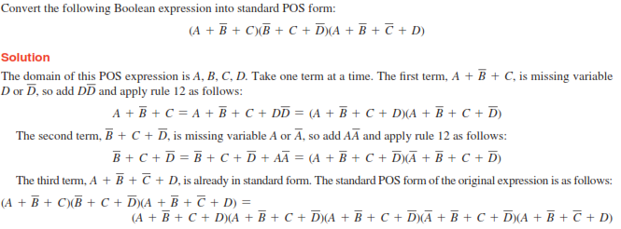
Converting a Sum Term to Standard POS (cont.)
(A + B)(A + C) = A + BC: rule 12, A= A+B’+C , B= D, C= D’)

Slide 16
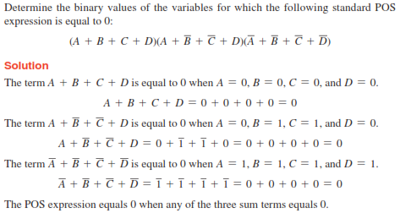
Binary Representation of a Standard Sum Term
A POS expression is equal to 0 only if one or more of the sum terms in the expression is equal to 0

Slide 17
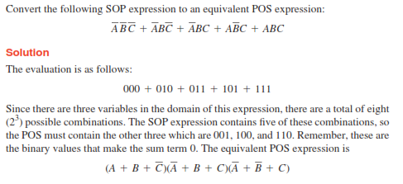
Converting Standard SOP to Standard POS

Slide 18
Class Task
Convert the following expressions to sum-of-product (SOP) forms
Convert each SOP expression to standard SOP form:

Slide 19

Solution

